Slide 1
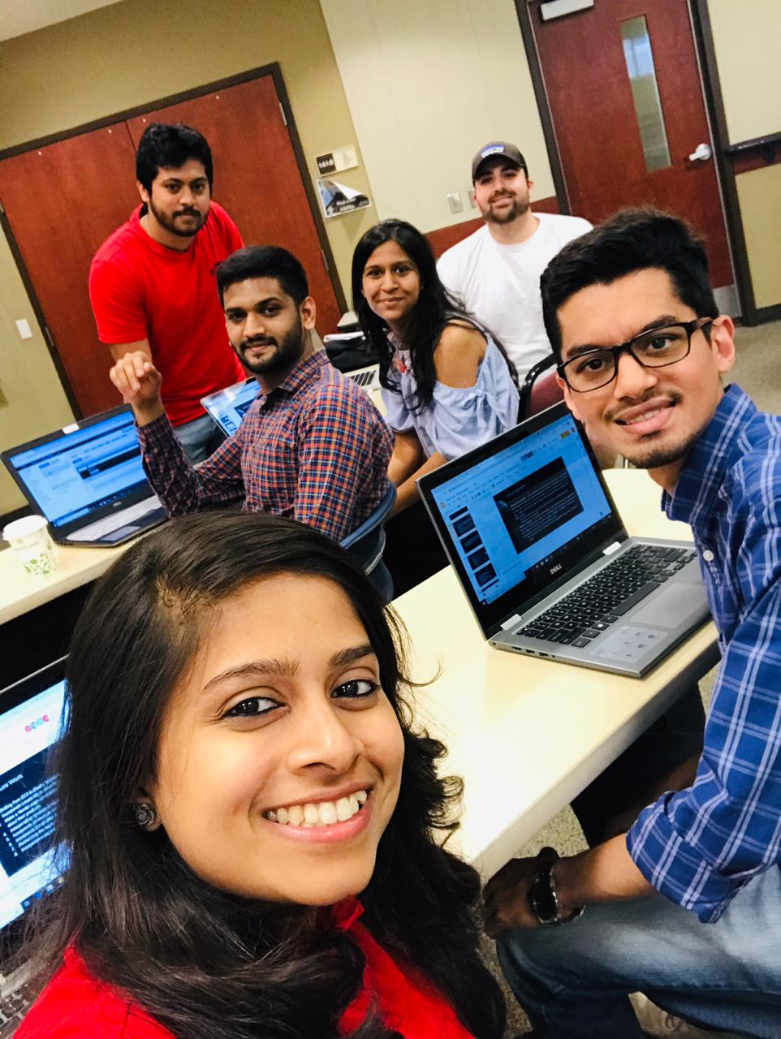
EventLite
We Google Everything
Adwait Tathe
Anant Paradkar
Deekansha Tandon
Joey Birch
Nithin Huliyappa
Priyanka Pradeep Rane

Slide 2
Business Problem
Local Events are occurring daily/weekly all across the US. How can users easily find local events within their local area?
Getting the notice out for these events could be costly and ineffective depending on the platform they’re advertising on.
Having 1 platform that displays all the local events, in a easy to read format, within a given area
How do you know if your friends are attending the same event as you and where can you go to obtain more information about the events?

Slide 3
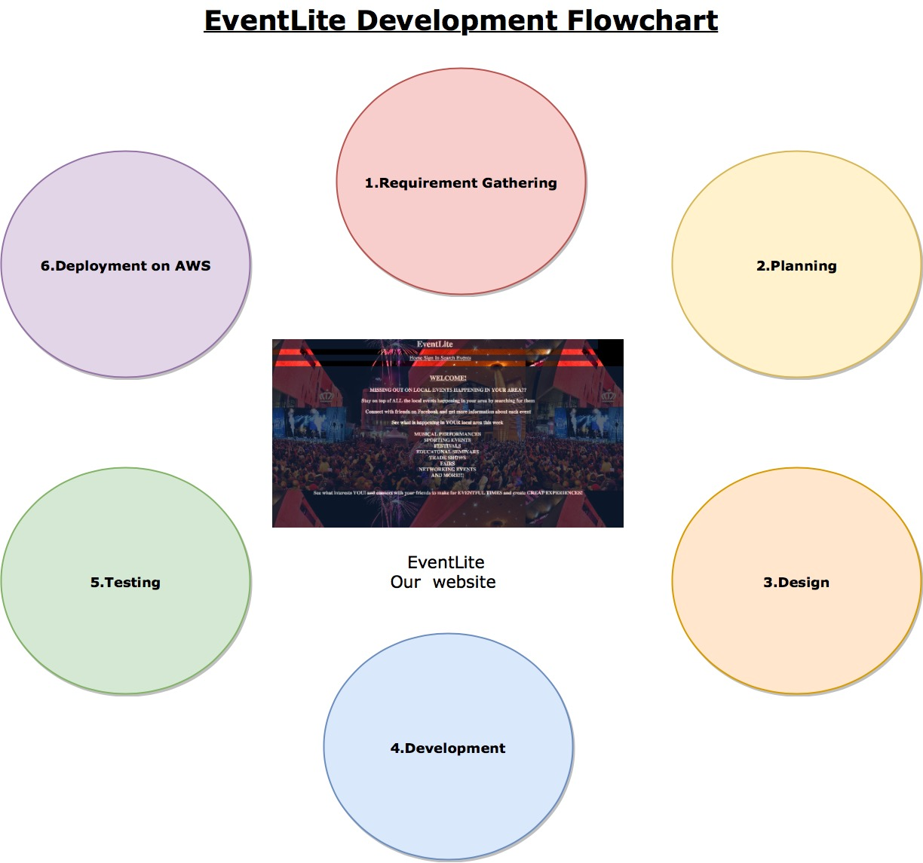
Development Flowchart
Requirement Gathering
We all met and discussed different ideas for the project and agreed upon EventLite application. Went back and thought of different ideas to include in the application
Planning
Discussed the overall layout of the app and distributed the work among teammates
Design
We met and discuss individual webpages that were needed and the different AWS components we would like to use in this application

Slide 4
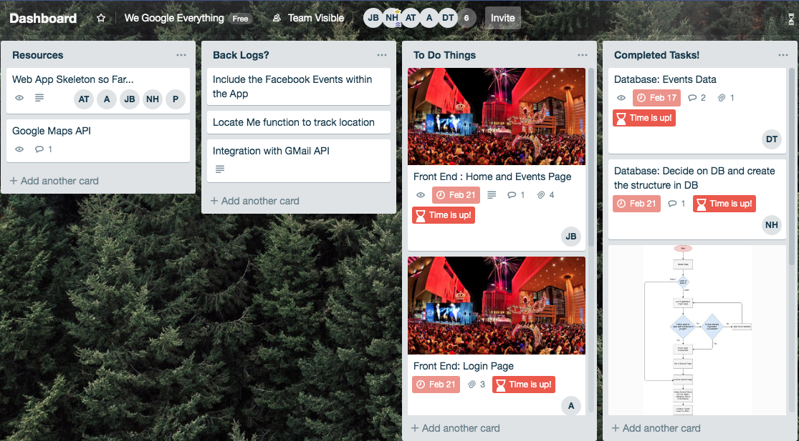
Development Flowchart
Development
We developed the frontend using HTML/CSS/Javascript.
Used AWS Cognito for authentication
Used DynamoDB for storing our database
Twilio for sending communication
Testing
To insure we were able to make queries to the database and fetch the data.
Deployment
Team worked together deploy our Application on an EC2 instance

Slide 5
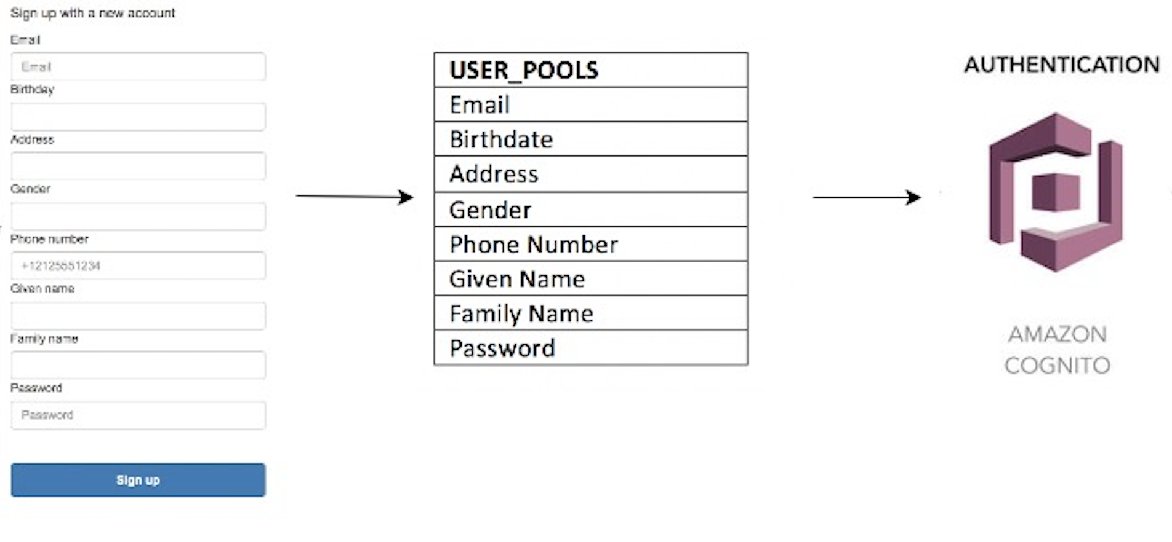
Data Diagram

Slide 6
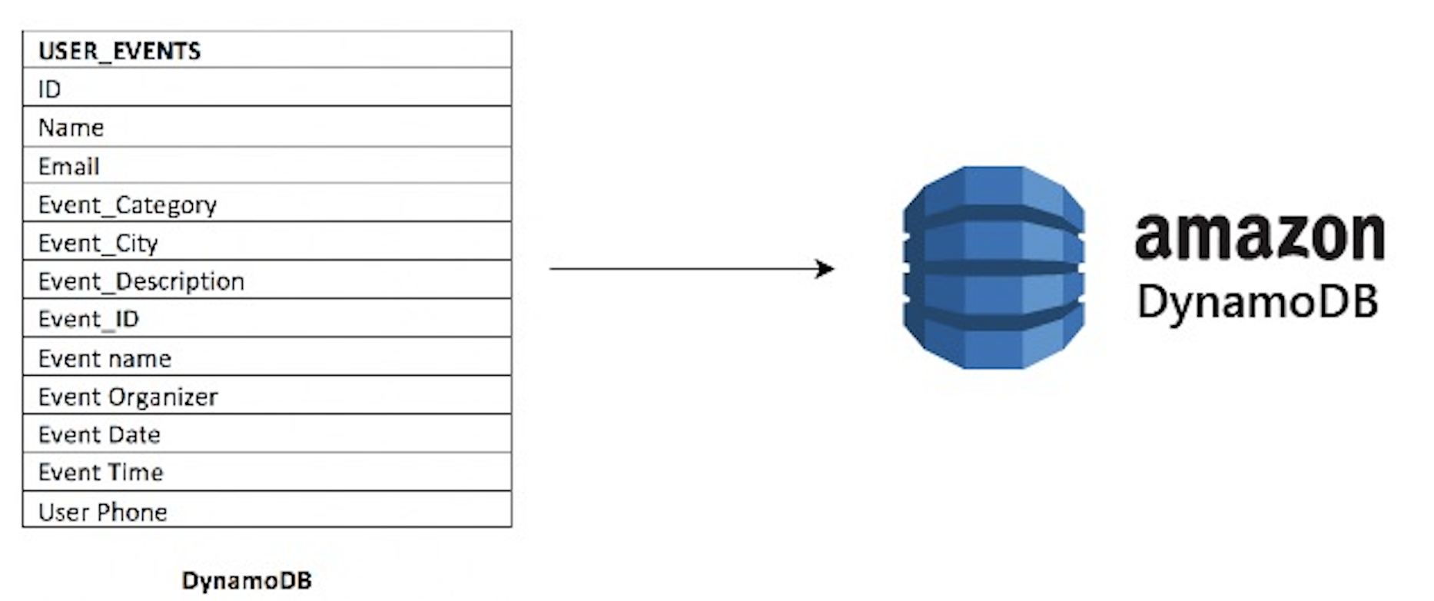
Data Diagram
This table consist of a mix between user data and event data stored when the user registers for an event
The event data is also stored within a DynamoDB database

Slide 7
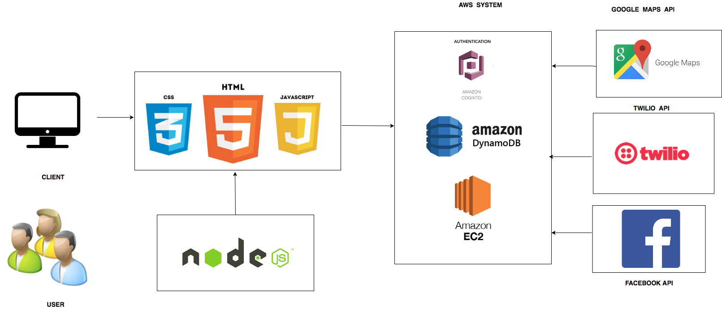
System Diagram
Notes:
https://www.google.com/url?sa=i&source=images&cd=&cad=rja&uact=8&ved=2ahUKEwi-_r66xbfhAhVwhuAKHbsDADIQjRx6BAgBEAU&url=https%3A%2F%2Fsecurity.ufl.edu%2Fit-workers%2Frisk-assessment%2Fcreating-an-information-systemdata-flow-diagram%2F&psig=AOvVaw1plUMMJpDc3XHvhlUiOskL&ust=1554505235258385
https://www.google.com/url?sa=i&source=images&cd=&cad=rja&uact=8&ved=2ahUKEwilnrHaxbfhAhVqmeAKHXY6CrEQjRx6BAgBEAU&url=https%3A%2F%2Fwww.researchgate.net%2Ffigure%2FProposed-Architecture-Figure-shows-the-simple-block-diagram-of-the-recommender-system_fig1_303922982&psig=AOvVaw059cODb0tkQP0Mb_6Y_L5i&ust=1554505312695574
https://www.google.com/url?sa=i&source=images&cd=&cad=rja&uact=8&ved=2ahUKEwjinsPixbfhAhXCTN8KHffHA4MQjRx6BAgBEAU&url=https%3A%2F%2Fwww.quora.com%2FHow-do-I-draw-the-system-architecture-diagram-of-an-IT-project&psig=AOvVaw059cODb0tkQP0Mb_6Y_L5i&ust=1554505312695574

Slide 8
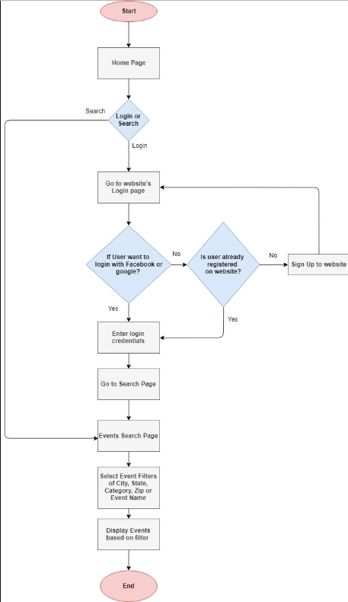
Logical Diagram
When user opens the application they will be brought to our home page.
The home page display information about the website and allows the users to either login or search for events as guest.
If the user wants to login using EventLite
they will be sent to our login page to either sign in using Facebook/Google or register for the first time.
The searchEvents page is where users can filter events in their area.
On click search, their results will be displayed dynamically with a map view.

Slide 9
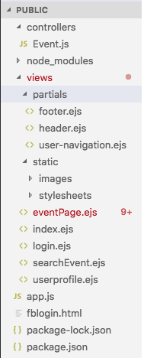
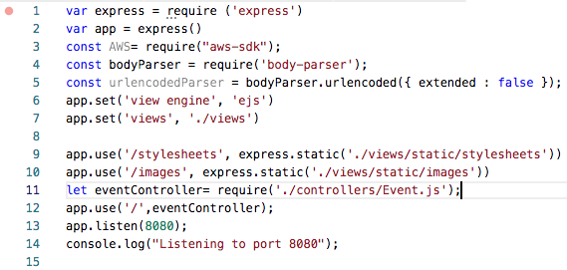
Application Highlights
<-- Displays our application structure
Code displaying our apps.js file

Slide 10
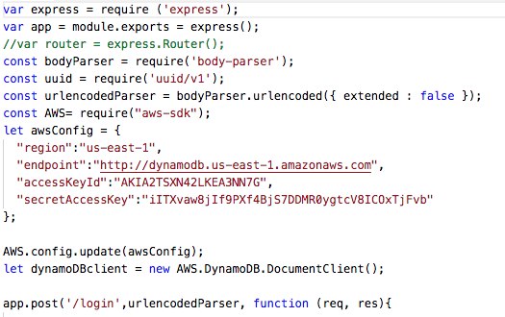
DynamoDB Integration
The AWS Config parameter to connect to AWS console
Region
Endpoint
Id Credentials
DynamoDB client taken from aws sdk.

Slide 11
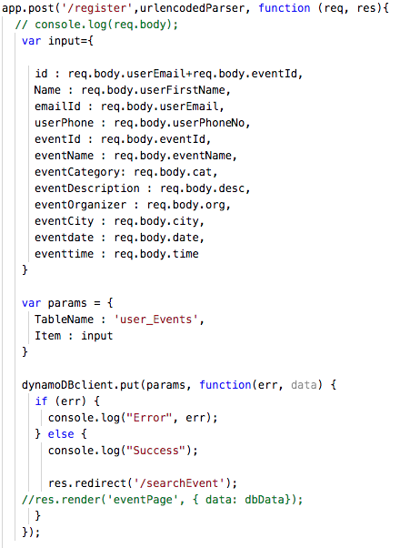
User Event details insert in DynamoDB
Created Input object with user and event details that needs to be added to DynamoDB.
Params object with Table Name and Input.
Put method of DynamoDB Client to add details in DynamoDB

Slide 12
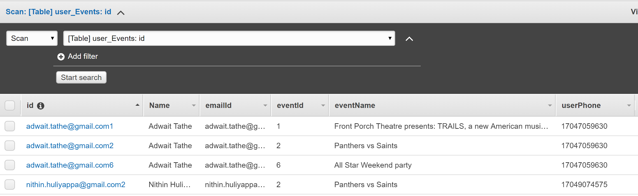
User Events Table
User Events Table store details of user and their respective added Events
Primary Key : emailId + EventId

Slide 13
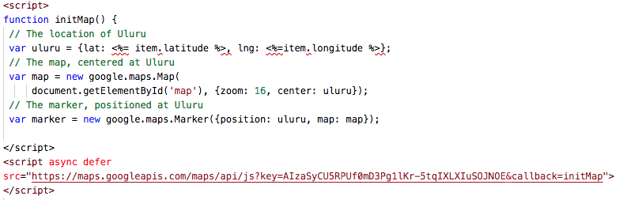
Google Maps Integration
API key with JavaScript API enabled for Google Maps
Event Latitude and Longitude are provided to place marker at event Location in Google Maps.

Slide 14
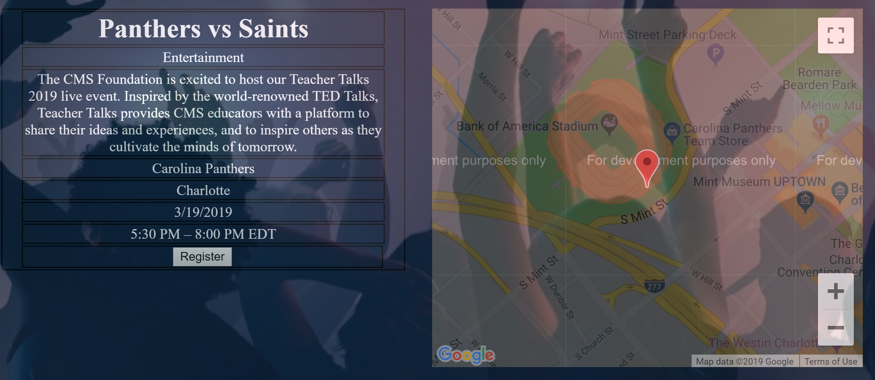
Event details snippet
Individual event details are show along with its location in google maps.
User can register for the event and add it in its bin.

Slide 15
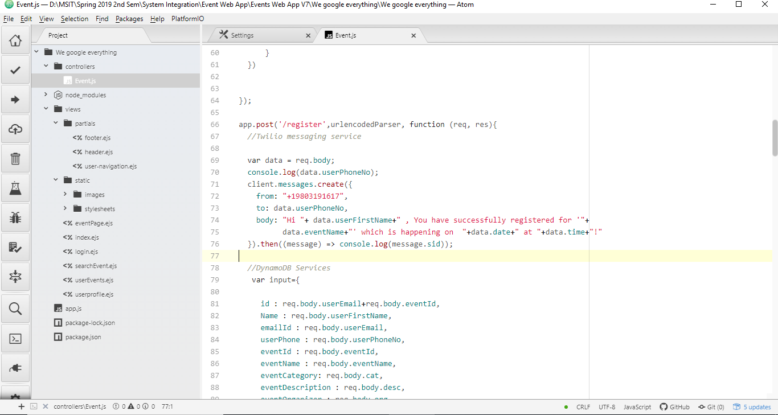
Twilio SMS API Integration

Slide 16
DEMO!!

Slide 17
Cloud Highlights
Amazon DynamoDB : NoSQL database that supports key-value pairs, data models and enables developers to build a serverless applications. DynamoDB has a flexible schema where each row can have any number of columns associated with it at any time. It allows developers to easily change table information without redefining the table schema
We used this service to store our event information within a json file to display this information when called upon
Amazon Cognito : It provides authentication, authorization and user management for web and mobile apps. Users can login directly with a username and password, or even through a third party such as Facebook, Amazon, or Google. The two main components of it are user pools and identity pools.
We incorporated this for the logging into our web application through either Facebook or Google.

Slide 18
Cloud Highlights
Amazon Elastic Compute Cloud (Amazon EC2) : It provides scalable computing capacity in the Amazon Web Services (AWS) cloud. It eliminates the need to invest in hardware, so as to develop and deploy applications faster. We can use Amazon EC2 to launch as many or as few virtual servers as we need, configure security and networking, and manage storage.
We used this service to deploy EventLite within AWS

Slide 19
Challenges
EBS and Serverless setup
Didn’t end up using a serverless setup and instead used an EC2 instance
Authentication
Understanding Auth Services and its configuration
Issue to oauth2/token endpoint
Passing the JWT returned from cognito services to backend

Slide 20
Future Work
Shifting from EC2 to Elastic Beanstalk
Incorporate Locate Me function to track location
Make a Vendor page so vendors attending the events can advertise about their products
Incorporate ad revenue into the application for profit
Incorporate Email clients within the application
Dockerizing the Application
Incorporate a payment system for users to pay to attend

Slide 21
Conclusion
Learned that we didn’t need to create a db file for login information for our users because Cognito creates an user directory for us when a user SignUp.
We explored the various services offered within AWS and chose the services that would work best with EventLite
Learned that in the long run for EventLite, it would be better to use a serverless state to deploy the application

